Slide 1
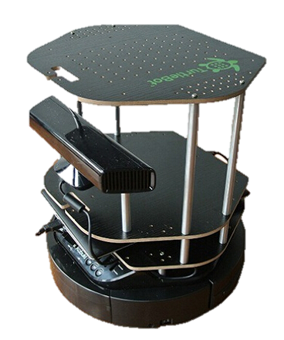
CMP3103M – Autonomous Mobile Robotics
Luke Exton EXT12454556

Slide 2
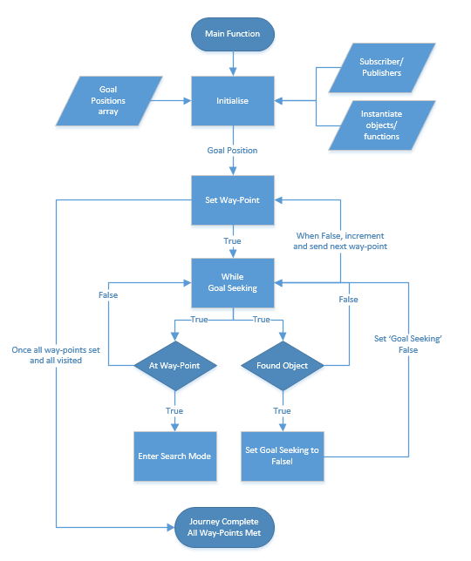
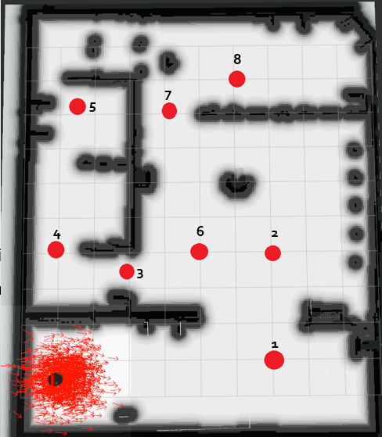
System Design
Boolean Logic Diagram
Mapping using Move_Base way-points

Slide 3
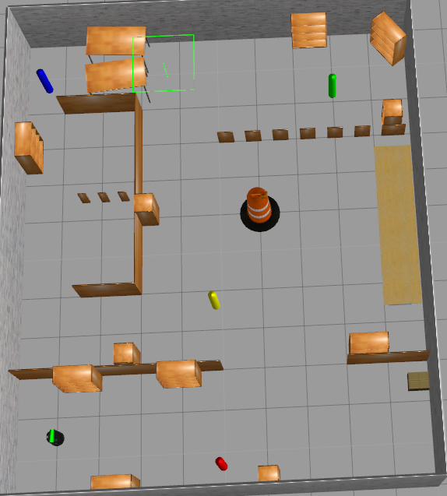
Results
Observations
Obstacle avoidance incredibly difficult to implement. Mostly handled by Move_Base – however once RVIZ and Gazebo were out of sync, awful!
Development was time consuming due to software not resetting properly.
Asynchronous development can often conflict, particularly with the use of local and global variables
Sequential observation but conducted asynchronously.
Robot behaviour was consistently inconsistent.
Use of in-built libraries can be hugely useless and yield successful results.
Testing Methods
AGILE style development process. Build and test each component bit-by-bit.
Components such as ‘Set Way-Point’ - does it set a way point? Yes, no? If so, is it in the right place? Etc. etc.
Used RVIZ and created a mapping extension to monitor robot movement in real time and goal setting.
Used Gazebo to monitor robot movement within the environment.
Use of terminal and print statements to monitor robot’s function calls in real time – this was particularly helpful when it came to debugging.
Performance Evaluation
Performance was evaluated by a consistency and speed
How fast was the robot completing the course?
How consistently was it finding all of the monuments?
This process iterated through various test layouts and an average was taken to measure the effectiveness of the algorithms
Fig. 1 – Arena testing by moving pillars

